Slide 1


Air Quality from Space with Artificial Intelligence: The NASA TEMPO Project
Hatice GAZEL
PulsarX

Slide 2


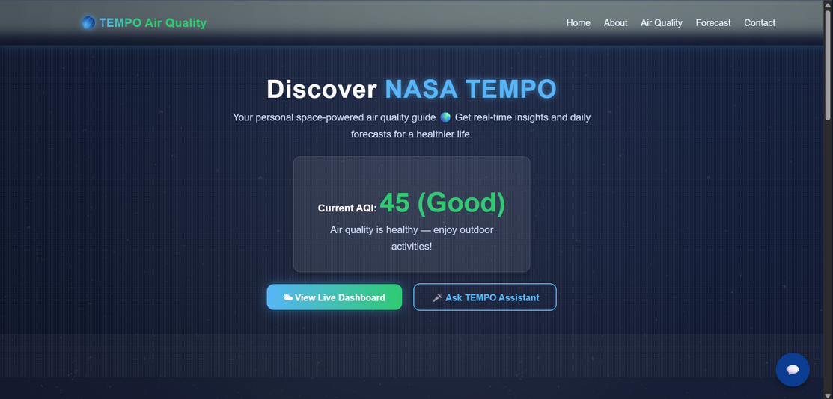
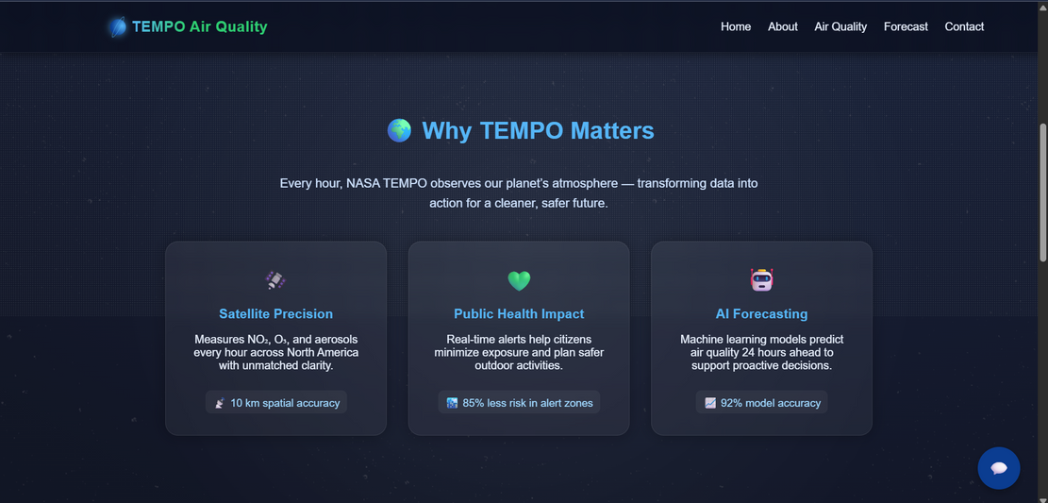


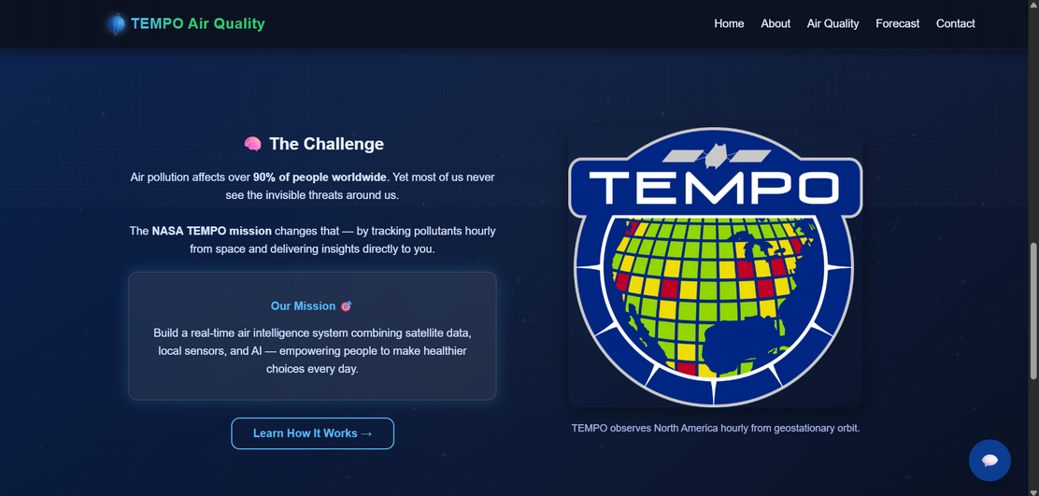
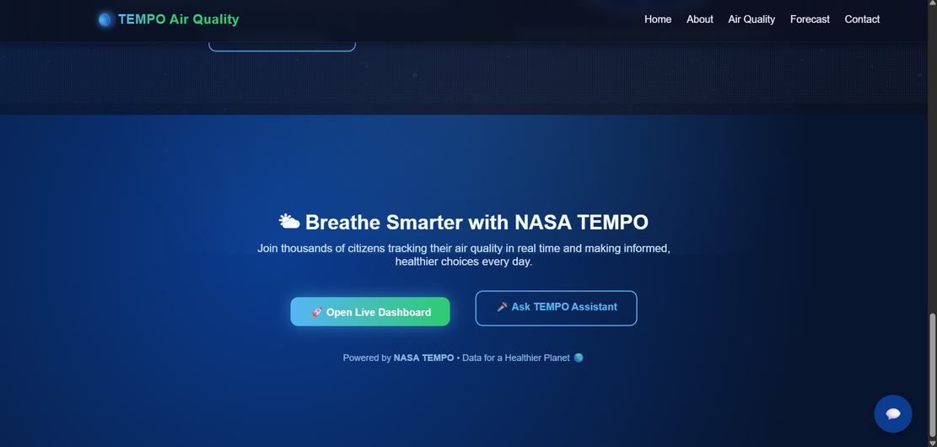
HOME PAGE

Slide 3
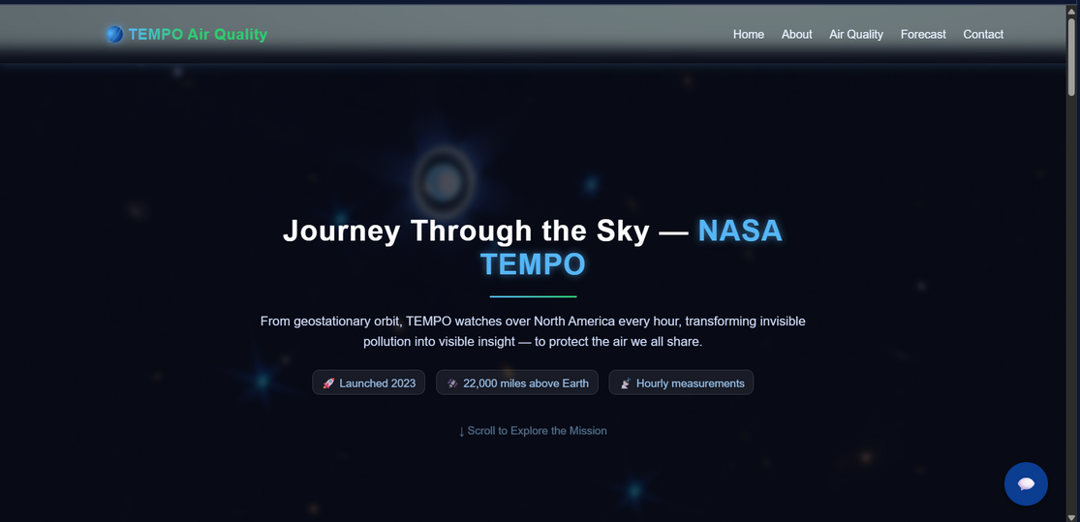
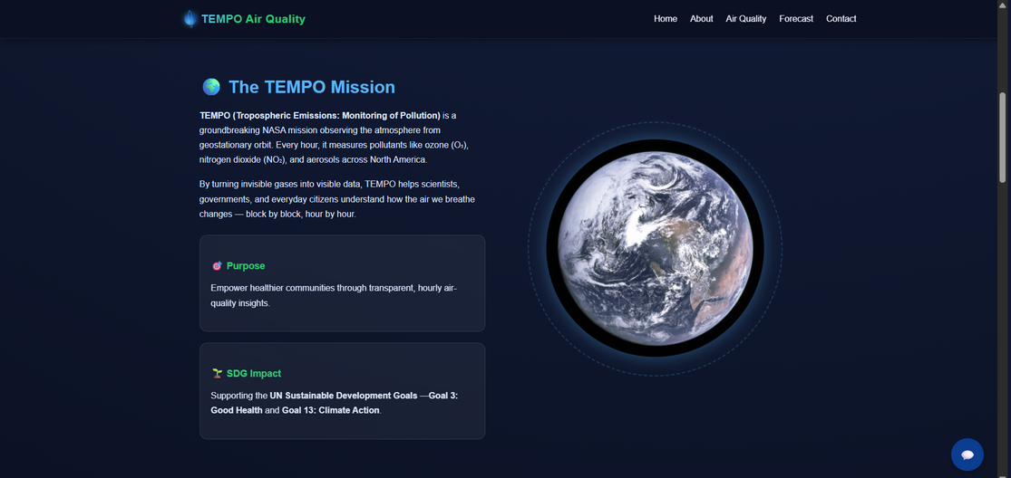
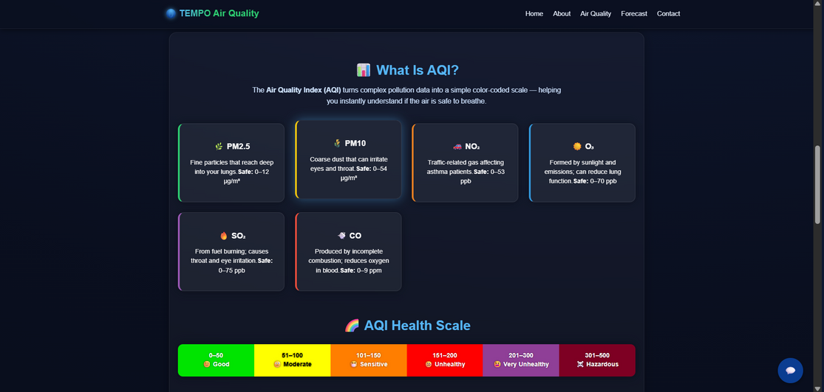
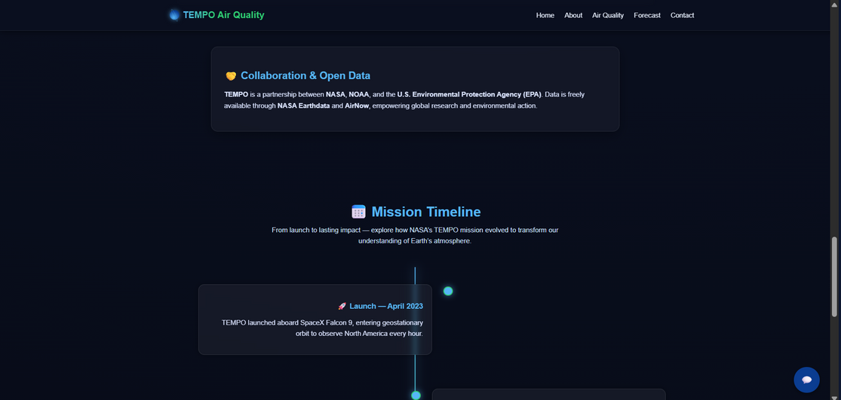
ABOUT PAGE

Slide 4

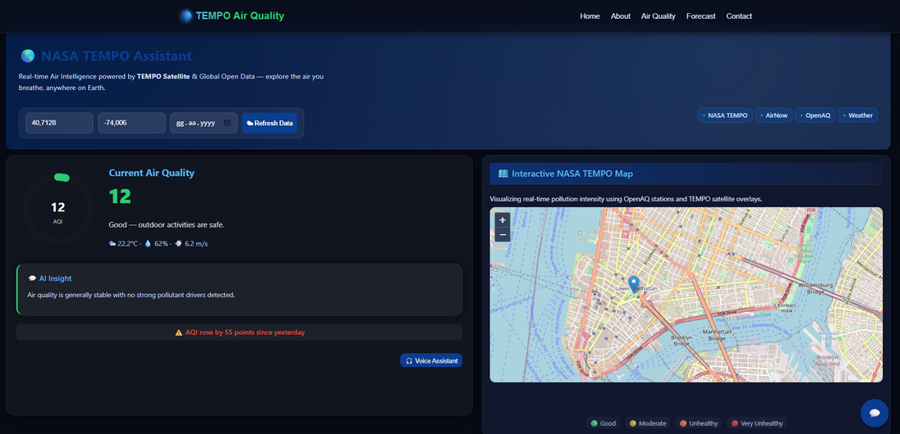
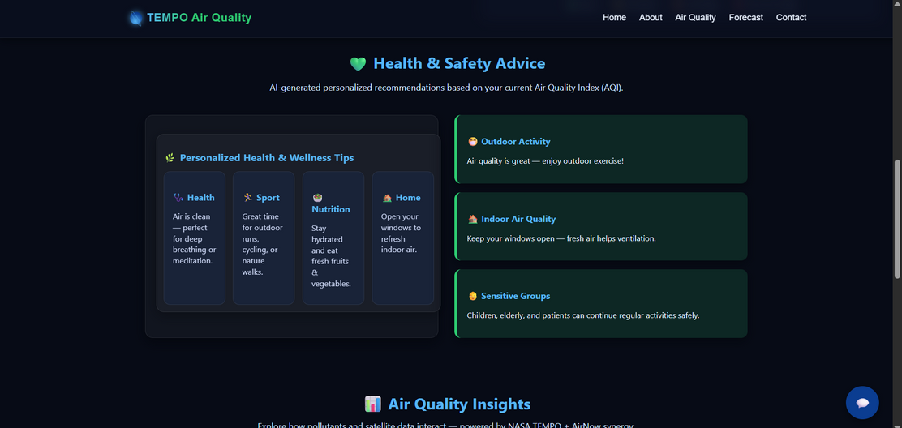
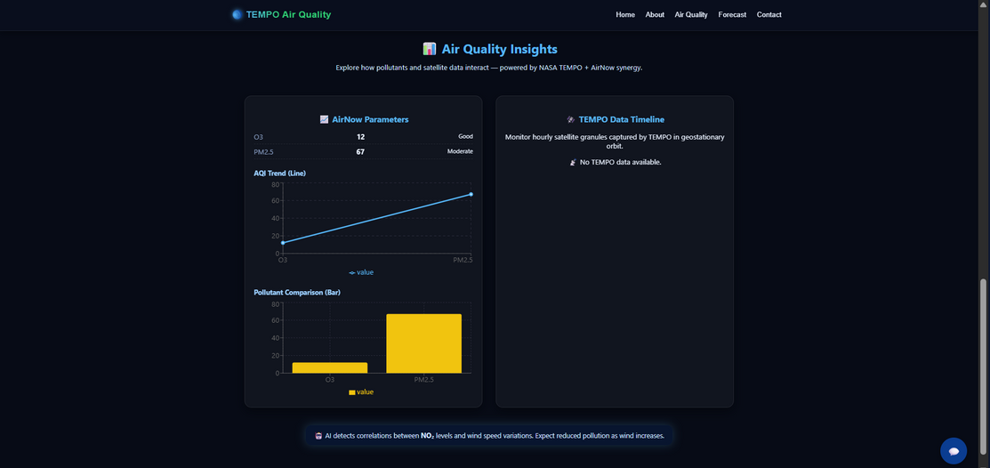
AİR QUALİTY PAGE
Air Quality Backend Technologies:
Python (Flask): API developed to process air quality data and deliver it to the frontend.
Machine Learning (Random Forest): Trained model for predicting AQI (Air Quality Index).
Data Integration (AirNow & TEMPO API): Integrated real-time satellite and sensor data.
Data Processing (Pandas, NumPy): Cleaned and transformed data into an analyzable format.
Forecast API: Generated weekly air quality forecasts and provided them in JSON format.

Slide 5

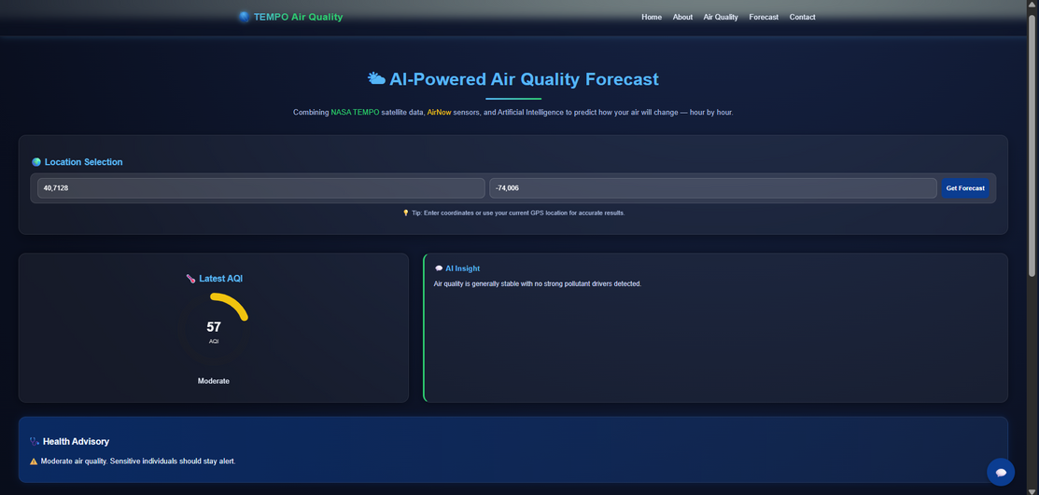
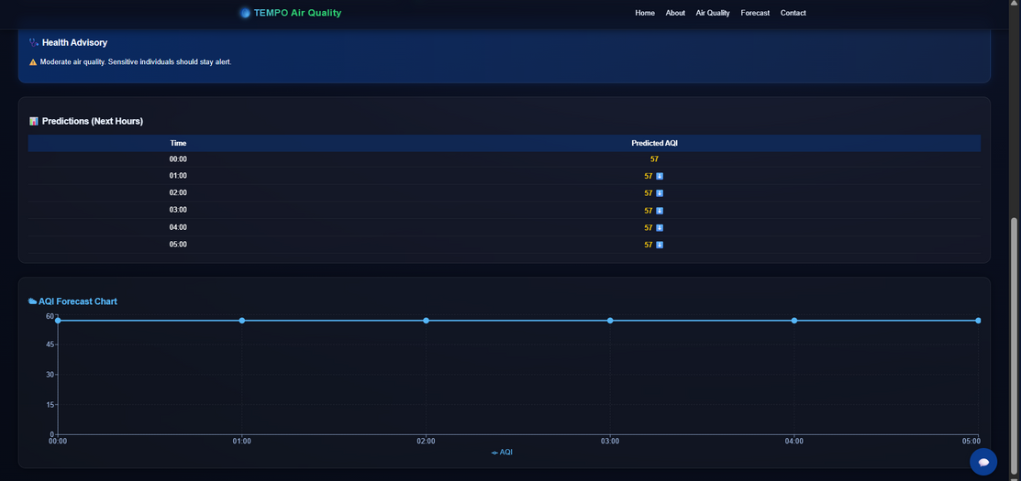
FORECAST PAGE
Forecast Backend Technologies:
Python (Flask): Developed API to deliver forecast results to the frontend.
Machine Learning (Random Forest): Built a model for weekly air quality (AQI) prediction.
Pandas & NumPy: Used for feature extraction and data preprocessing.
Scikit-learn: Applied for model training and performance evaluation.
JSON API (Flask Route): /forecast_api endpoint provides forecast data in JSON format.

Slide 6

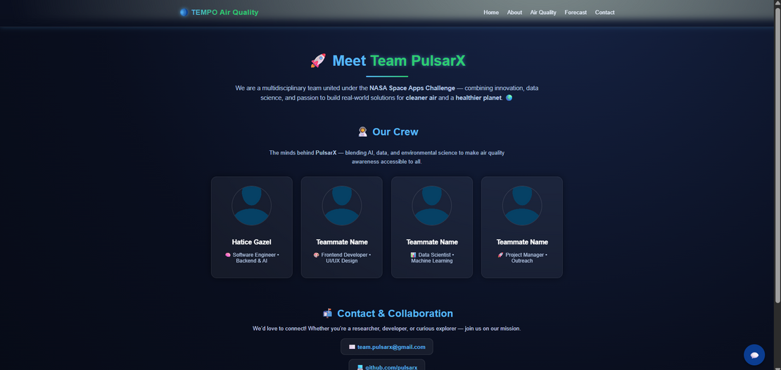
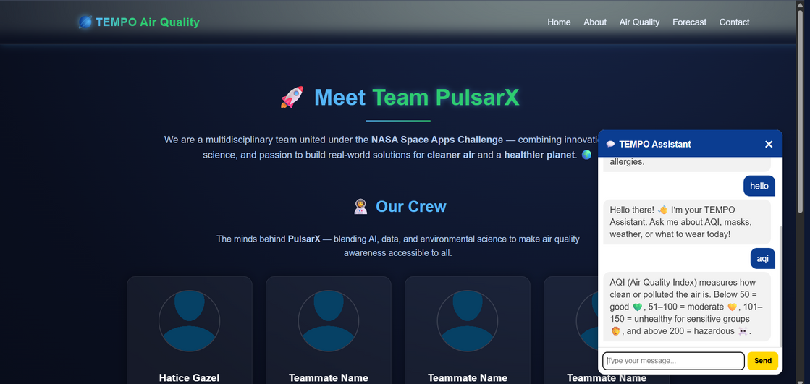
CONTACT & CHATBOT PAGE
Chatbot Backend Technologies:
Python (Flask): Backend API developed to handle user messages and return AI-generated responses.
Natural Language Processing (NLP): Implemented to understand user queries about air quality and provide meaningful answers.
Rule-based & Contextual Reply System: Designed to detect keywords (e.g., AQI, mask, weather, health) and generate dynamic insights.
AI Insight Engine: Offers personalized suggestions based on current AQI levels and health conditions.
JSON Communication: Ensures smooth and secure data exchange between the frontend and backend.

Slide 7

Thank You

